Slide 1
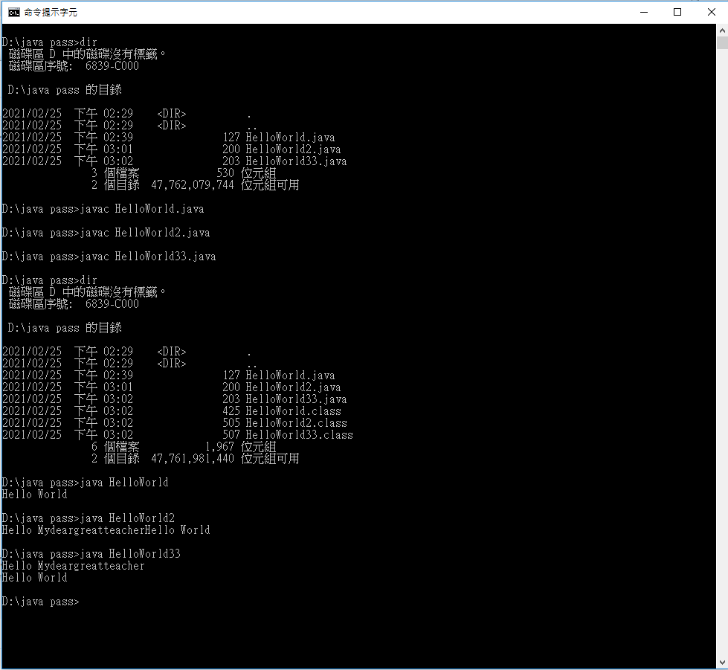
println()和print()有何差別?

